Slide 1
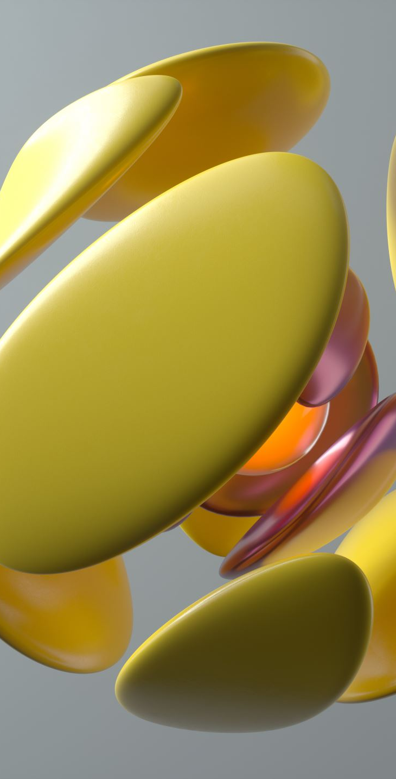
The DNA of Design
Elements of Design – Building Blocks of Visual Communication
Notes:
Today we’re continuing with the foundations of design—what we call the Elements of Design.”
As a reminder - Think of today as learning the ingredients of all design. Just like you can’t cook without ingredients, you can’t create effective visual communication without these elements.
By the end of today, you’ll start to see these elements everywhere—on posters, in apps, in packaging, even in social media graphics. You’ll notice design differently, and that awareness will make you stronger designers.

Slide 2
Elements of Design
Line:
Shape:
Direction:
Size:
Texture:
Colour:
A path between two points
A two-dimensional enclosed space
The orientation or movement of elements
The relative scale of elements
The surface quality of an object
The perception of light reflected from surfaces
Notes:
These are the six essential building blocks of visual design.”
Each one might seem simple, but designers use them deliberately to guide attention, create impact, and send messages.”
Think of them like a recipe: today we’ll look at each ingredient, and later in the course, we’ll learn how to combine them with the principles of design—like balance, alignment, and contrast.”
On the next few slides, we’ll dive into each element, one at a time.”

Slide 3
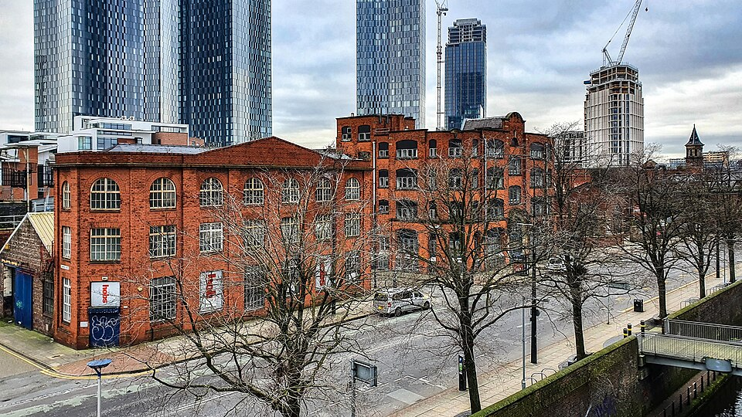
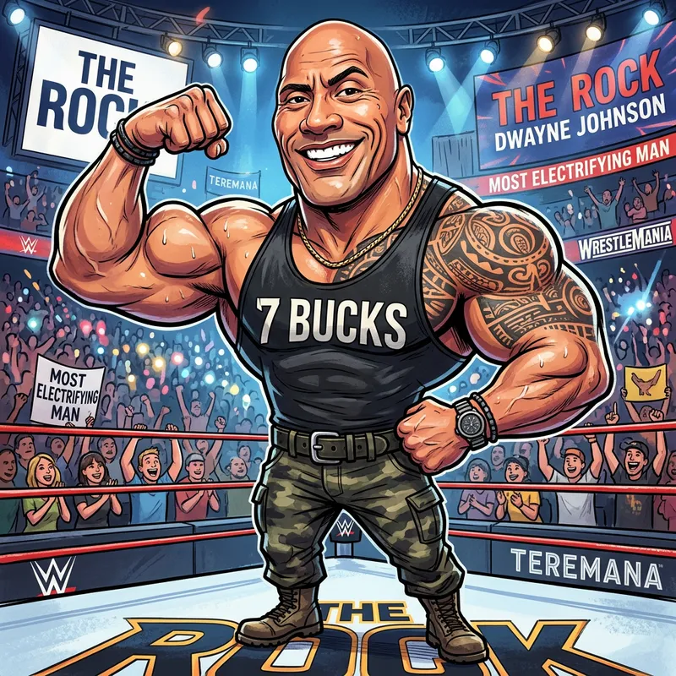
Scale & Proportion
Scale
How large or small something is compared to its surroundings
Proportion
The relationship between parts of the same object
Notes:
Many people think scale and proportion are the same thing, but they are slightly different.
Scale refers to the size of something compared to other objects around it.
For example:
A billboard is larger than a poster.
A skyscraper is larger than a house.
Proportion is how the parts of something relate to each other.
Think about:
A realistic human figure
A cartoon character with an oversized head
The character may be large or small, but the exaggerated head changes the proportion.
Designers intentionally alter proportion to:
Attract attention
Create humour
Communicate importance
Create visual interest
Ask students: "Why do cartoon characters often have larger eyes than real people?“
Image from: File:Whitworth House and Wrendal House - geograph.org.uk - 6713521.jpg - Wikimedia Commons
https://commons.wikimedia.org/wiki/File:Whitworth_House_and_Wrendal_House_-_geograph.org.uk_-_6713521.jpg
Dwayne Johnson Caricature - Fun & Unique Artwork | AI Art Generator | Easy-Peasy.AI
https://easy-peasy.ai/ai-image-generator/images/dwayne-johnson-caricature-5095beaf-6eb4-4304-8489-ce9eebf158ae

Slide 4
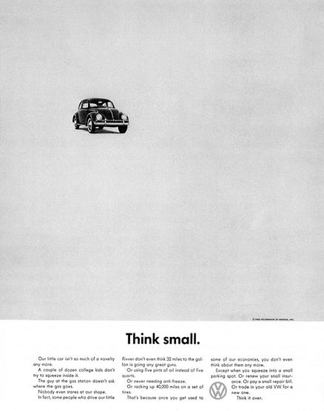
Size
The relative scale of elements in a design
Establishes hierarchy
Shows importance
Creates emphasis
Notes:
Definition (Slide Copy): The relative scale of elements in a design.
Why it matters (Speaker Notes):
Size is one of the clearest ways to create hierarchy. The biggest element draws the most attention.
Image from
The ad that changed advertising.. Bill Bernbach had a problem. Carl Hahn… | by Mark Hamilton | The Agency | Medium
https://medium.com/theagency/the-ad-that-changed-advertising-18291a67488c

Slide 5
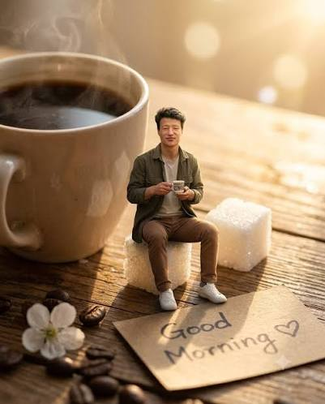

Size Creates Meaning
Notes:
Size can change the message completely.
When an object is made very large it can suggest:
Power
Importance
Strength
Dominance
When an object is made very small it can suggest:
Vulnerability
Distance
Isolation
Insignificance
Designers use size to influence how viewers feel about subjects before they read a single word.
Image from (4) ChatGPT Polska - PROMPTY, PORADY, TRIKI, ZASTOSOWANIE AI | Facebook
https://www.facebook.com/groups/6214467021932639
Instagram
https://www.instagram.com/p/DcaozKcEdan/

Slide 6
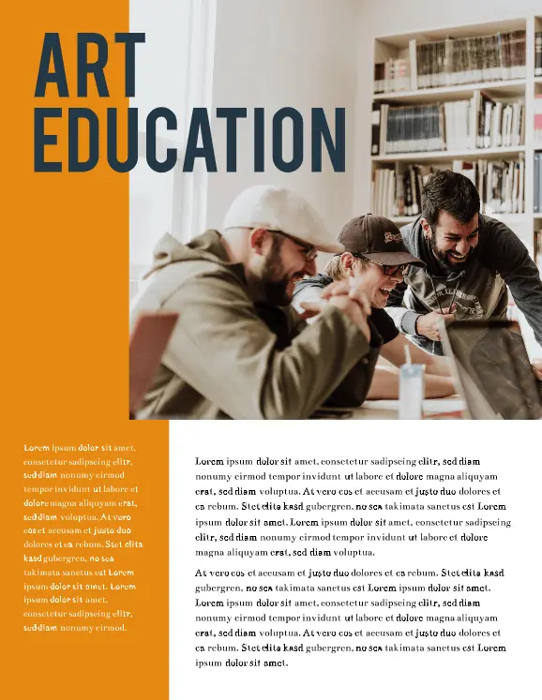
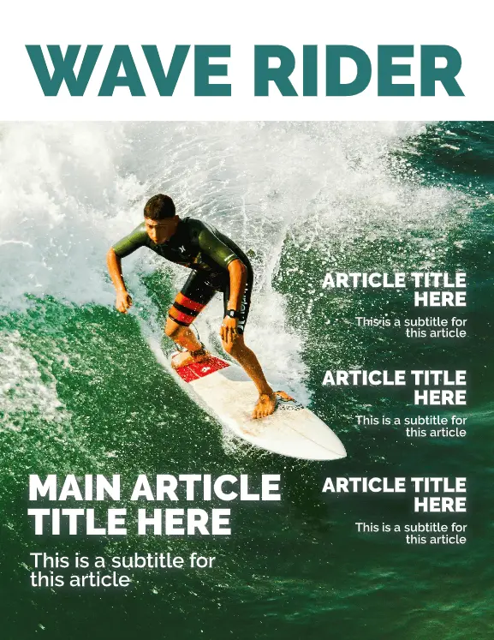
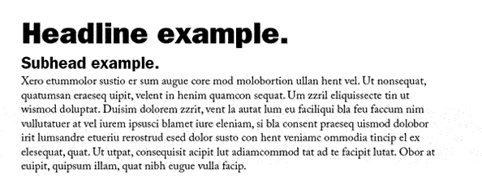
Size - Text
Notes:
Designers use size to show importance (headlines larger than body text).
Images from
30 Magazine Design & Layout Ideas to Spark Your Creativity – Marq
https://www.marq.com/blog/14-magazine-layout-design-ideas-for-your-inspiration

Slide 7
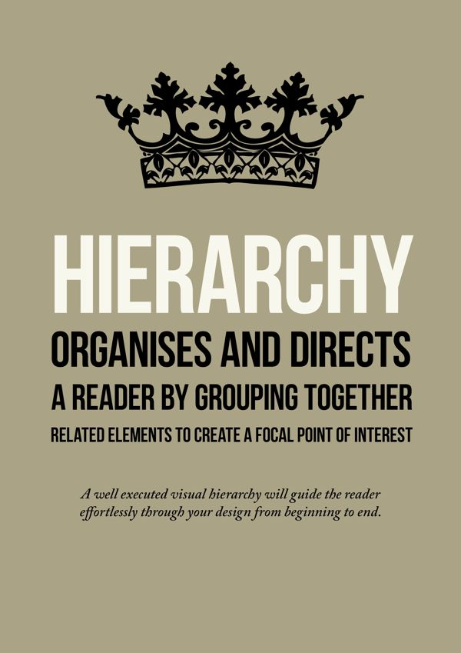
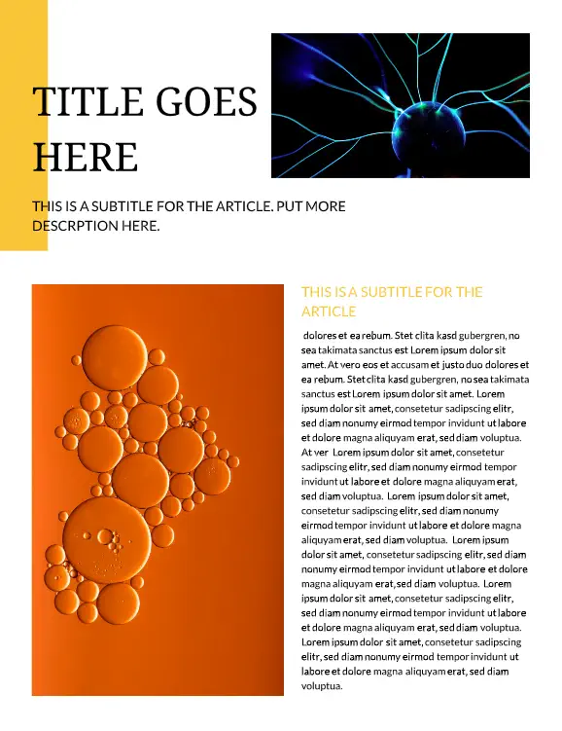
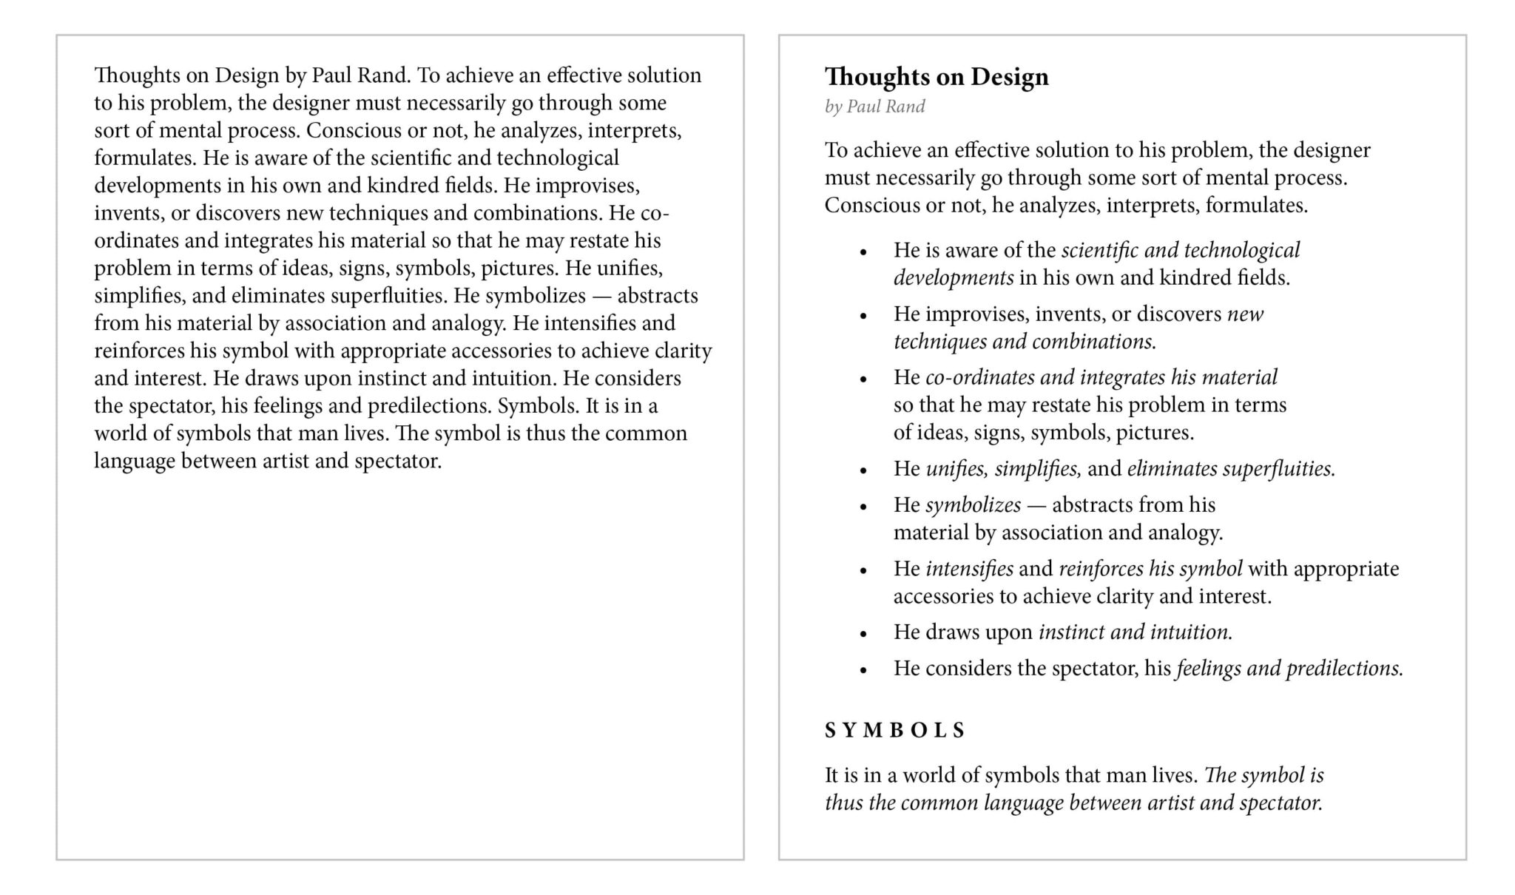
Size - Navigation
Notes:
Contrast in size creates interest and makes designs easier to navigate.
Images from
30 Magazine Design & Layout Ideas to Spark Your Creativity – Marq
https://www.marq.com/blog/14-magazine-layout-design-ideas-for-your-inspiration

Slide 8

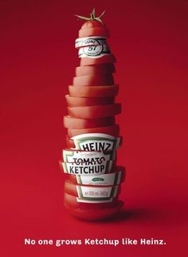
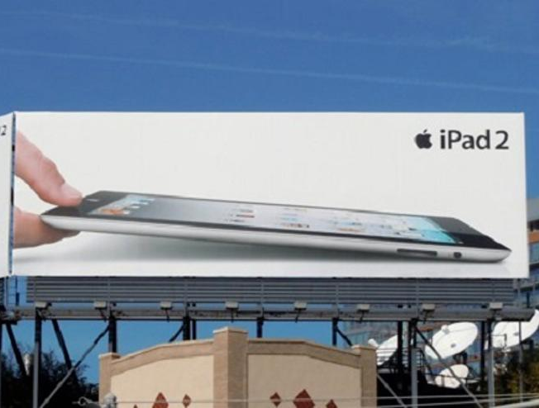
Size - Imagery
Notes:
Definition (Slide Copy): The relative scale of elements in a design.
Why it matters (Speaker Notes):
Oversized imagery can create drama; small subtle elements can create intimacy.
Example to show: Apple product ads → the iPhone dominates the page, with small supporting text.
Notice how many advertisements make the product much larger than it would appear in real life.
This creates:
Emphasis
Importance
Memorability
Think about movie posters.
The main character is often the largest element because the designer wants viewers to immediately understand where to focus.
Image from
emily-didonato-maybelline-01.jpg (426×554)
https://samtakesmedia.wordpress.com/wp-content/uploads/2015/04/emily-didonato-maybelline-01.jpg

Slide 9
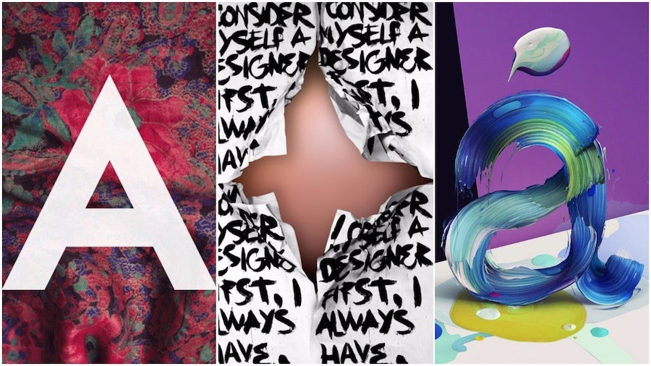
Texture
The surface quality of an object, real or implied.
Visual or tactile quality
Adds depth
Creates mood
Notes:
Definition (Slide Copy): The surface quality of an object, real (tactile) or implied (visual).
Why it matters (Speaker Notes):
Texture adds richness and depth, preventing designs from feeling flat.
Smooth textures feel modern, clean, and high-tech (Apple packaging).
Rough textures feel rugged, handmade, authentic (craft beer labels, outdoor brands).
Images from
Innovative approaches to texture in graphic design - 99designs
https://99designs.com/blog/tips/texture-in-graphic-design/

Slide 10
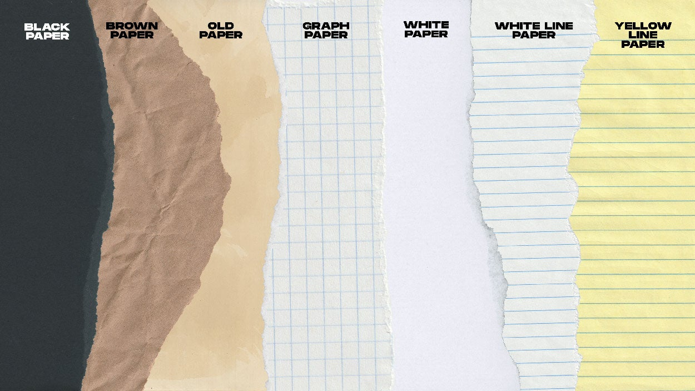
Texture Creates Experience
Adds realism
Creates emotional response
Increases engagement
Strengthens storytelling
Notes:
Texture makes designs feel more real and more believable.
Consider these examples:
A bakery package with a kraft-paper texture feels handmade.
A technology advertisement with smooth metallic textures feels modern.
A luxury brand often uses soft, elegant textures to communicate sophistication.
Texture helps audiences imagine touching an object even when viewing it on a screen.
This is called a visual texture.
Designers use visual texture to create sensory experiences.
Image from 9 Top Graphic Textures for Handcrafted Look | .png marker, .png marker graphics, .png marker pack and more | Sickboat Blog blog
https://sickboat.com/blogs/blog/top-textures-for-handcrafted-look

Slide 11
Texture and Brand Personality
Texture | Message
Smooth | Modern, clean
Metallic | Professional, technological
Wood | Natural, authentic
Fabric | Comfort, warmth
Stone | Strength, durability
Hand-drawn textures | Creative, personal
Notes:
Different textures communicate different personalities.
As designers, we choose texture for the same reason we choose colour or typography: to communicate a message.
Four brand examples:
Apple
Patagonia
Luxury skincare
Craft brewery
Show examples on website

Slide 12
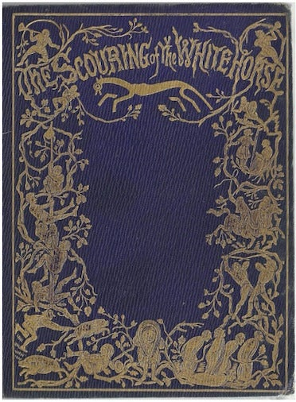
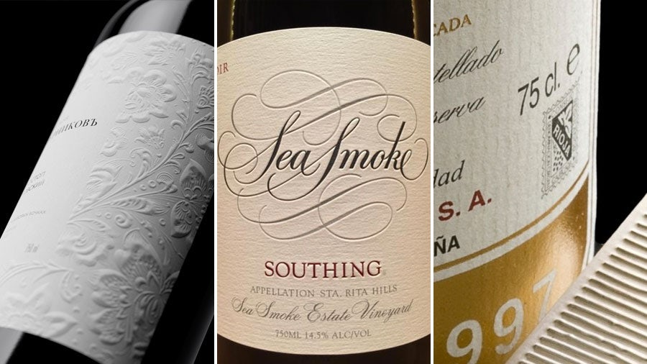
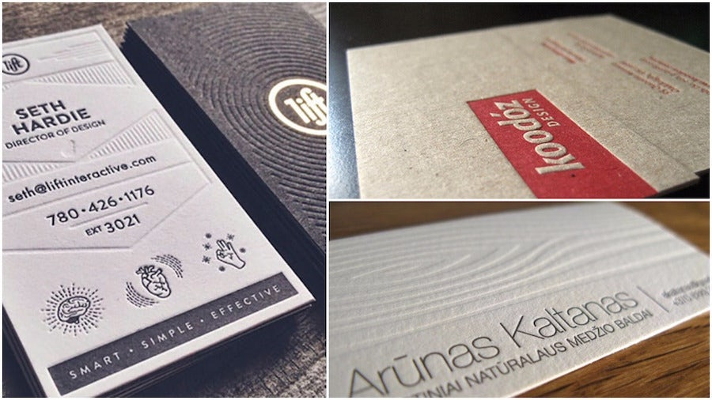
Texture - Tactile
Notes:
Definition (Slide Copy): The surface quality of an object, real (tactile) or implied (visual).
Why it matters (Speaker Notes):
It can be literal (raised printing, embossing, packaging material) or
Images from
Innovative approaches to texture in graphic design - 99designs
https://99designs.com/blog/tips/texture-in-graphic-design/

Slide 13
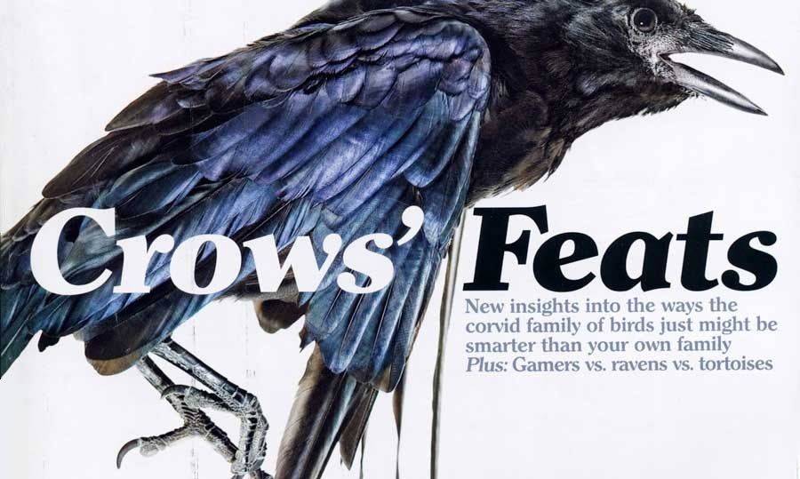
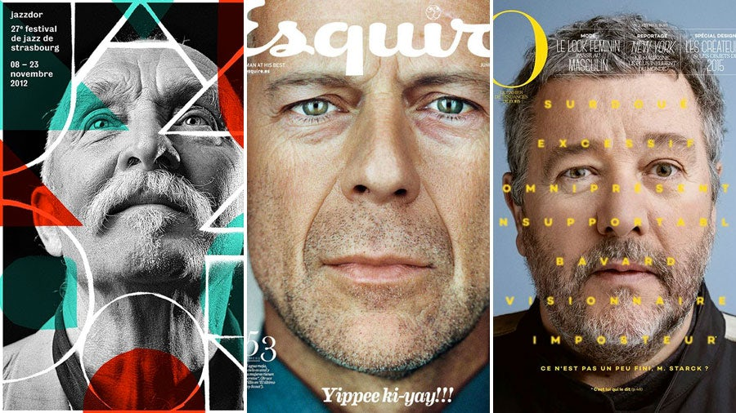
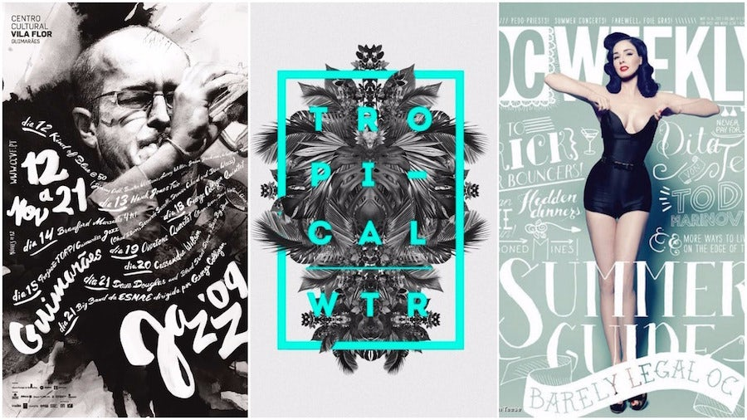
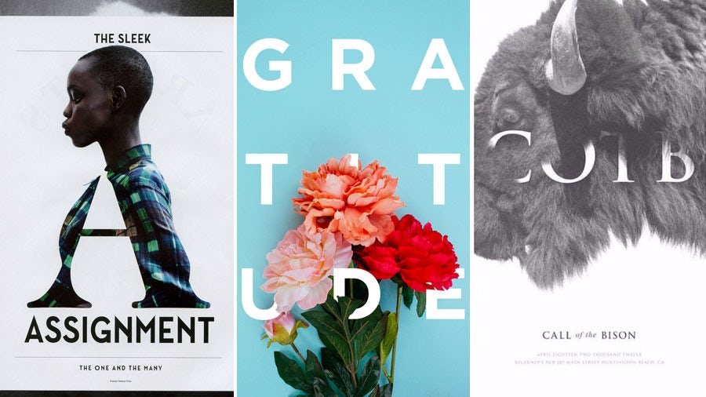
Texture - implied
Notes:
visual (photography of wood, metal, fabric).
Most graphic designers work with implied texture rather than physical texture.
For example:
A photograph of weathered wood
A brick wall background
Water droplets on packaging
Wrinkled paper effects
The surface is actually smooth, but our brain interprets the image as textured.
Images from
Innovative approaches to texture in graphic design - 99designs
https://99designs.com/blog/tips/texture-in-graphic-design/

Slide 14
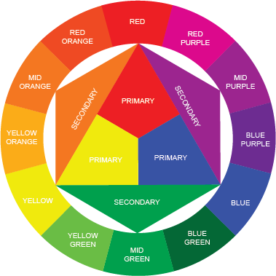
Colour
The perception of light reflected from surfaces, including hue, value, and saturation.
Creates mood
Attracts attention
Communicates meaning
Notes:
Definition (Slide Copy): The perception of light reflected from surfaces, including hue, value, and saturation.
Why it matters (Speaker Notes):
Images from
How to create the 6 most common colour schemes for your Surface Pattern Designs - Pattern and Design
https://patternanddesign.com/how-to-create-6-most-common-colour-schemes-surface-pattern-designs/

Slide 15
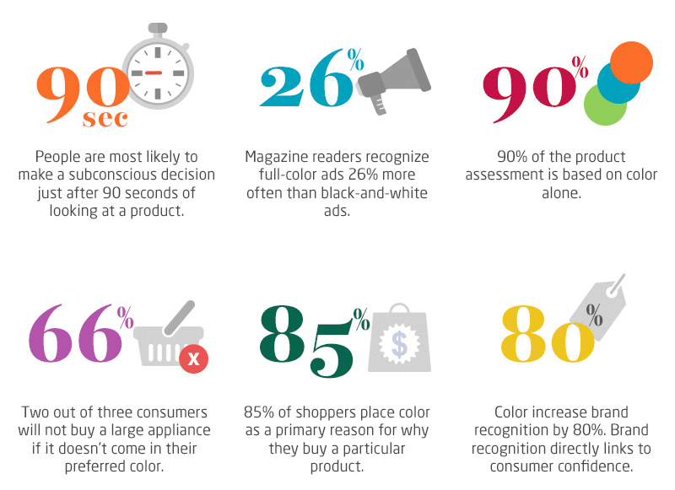
Colour - impact
Notes:
Products are made to be sold. Products sell when an audience finds your product more appealing than your competitors. For this to occur, your product must be attractive and memorable. A decision to buy often has as much to do with a buyer’s perception of a product as it does with the product itself.
Image retrieved from: http://bmighty2.com/wp-content/uploads/2016/02/Consumer-Buying.jpg

Slide 16




Colour - Emotion
Notes:
Colour is the most emotionally powerful element. It affects mood, meaning, and brand identity.
Red = passion, urgency, energy (Coca-Cola, Netflix).
Blue = trust, stability, calm (banks, healthcare, Facebook).
Green = nature, health, balance (Starbucks, Whole Foods).
Yellow = optimism, youth, energy (IKEA, McDonald’s).

Slide 17
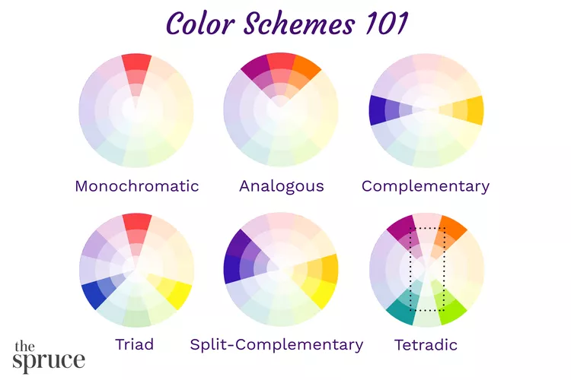
Colour - unity
Notes:
Colour creates unity through schemes (monochromatic, complementary, analogous) and directs attention.
Images from
How to Use the Color Wheel for Any Palette
https://www.thespruce.com/easy-color-schemes-from-color-wheel-797784

Slide 18
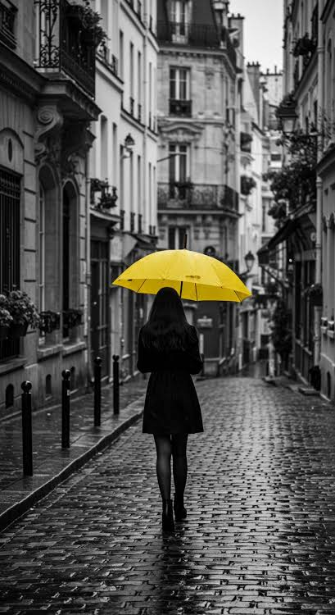

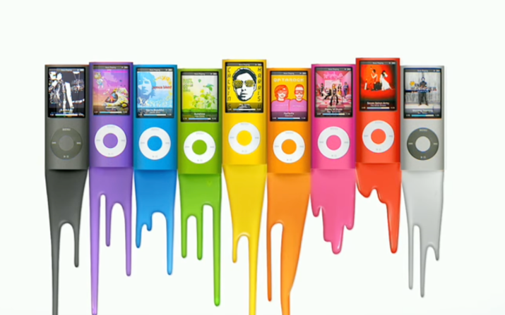
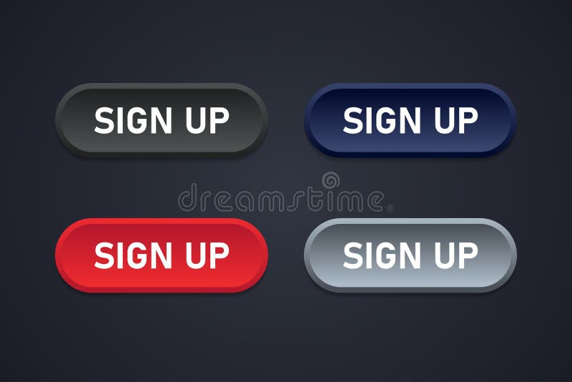
Colour Creates Contrast
Colour Directs Attention
High contrast attracts attention
Low contrast creates harmony
Contrast improves readability
Notes:
One of the most important functions of colour is directing attention.
READ SLIDE FIRST
Think about:
A red button on a grey page
Yellow text on a black background
A brightly coloured object in a black-and-white image
Our eyes naturally move toward areas with stronger colour contrast.
This is one of the most powerful tools designers have.
Image from Register Now Red Button Stock Illustrations – 2,854 Register Now Red Button Stock Illustrations, Vectors & Clipart – Dreamstime
https://www.dreamstime.com/illustration/register-now-red-button.html
A black background with yellow text that says good vibes. | Premium Vector
https://www.magnific.com/premium-vector/black-background-with-yellow-text-that-says-good-vibes_39550739.htm
End Of An Era: 7 Best iPod Ad Campaigns Through The Years
https://tslmedia.sg/ipod-ad-campaigns/
AI ARTE! | 🖤🎨 Monochrome Pop: Black & White + 1 Color Challenge
https://www.facebook.com/groups/1661334077921820/posts/1700037440718150/

Slide 19
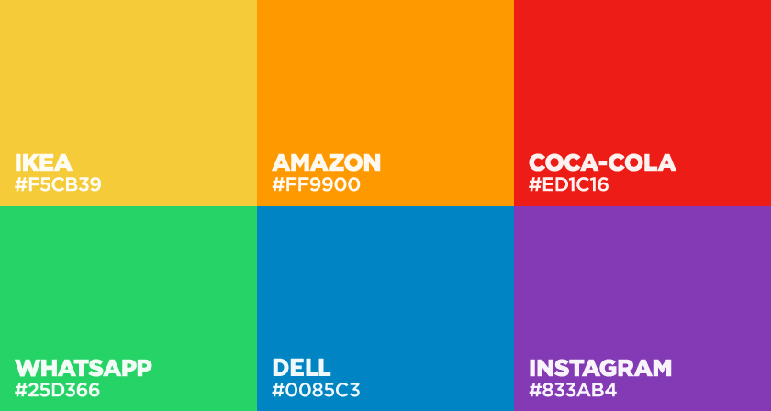


Colour Builds Recognition
Notes:
Colour helps audiences recognize brands instantly.
Many companies become associated with specific colours.
Sometimes people can identify a company before reading its name because of colour alone.
Consistency in colour builds familiarity and trust.
Image from Colors Used By Famous Brands (With Their Codes)
https://digitalsynopsis.com/design/brand-colors/

Slide 20
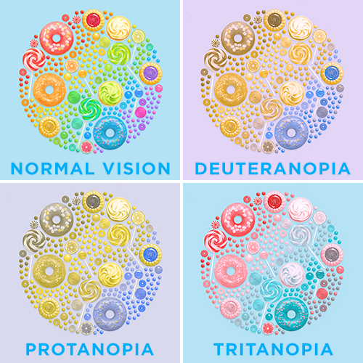
Colour and Accessibility
Never rely on colour alone
Consider colour blindness
Ensure sufficient contrast
Support readability
Notes:
Not everyone sees colour the same way.
Some users experience colour blindness or visual impairments.
There are 4 main types of color blindness; these range between red-green color blindness, blue color blindness, and monochromatic color blindness.
Good designers:
Use symbols along with colour
Provide sufficient contrast
Test designs for accessibility
A red-green comparison may be clear to some viewers but difficult for others.
Design should communicate effectively to the widest possible audience.
Images from:
Color Blindness 101: Causes, Types & Vision Tests | Eye Health
https://blog.eyeconic.com/eye-health/color-blindess-101.html

Slide 21
Elements We Learned Today
Size
Creates hierarchy and emphasis
Texture
Creates experience and depth
Colour
Creates attention, emotion, and meaning
Notes:
Today we explored three powerful design elements.
Size influences what we look at first.
Texture influences how something feels, even when we cannot physically touch it.
Colour influences attention, recognition, mood, and meaning.Individually these elements are powerful.
When combined, they become the foundation of effective visual communication and graphic design.

Slide 22
Elements We Learned Last Class
Line
Creates movement, structure, and visual pathways.
Shape
Creates meaning, organization, and recognition.
Direction
Guides the viewer's eye and influences how information is experienced.
Notes:
Last Class we explored three fundamental elements of design: line, shape, and direction.
Lines help create structure and movement. They can separate information, connect ideas, create patterns, and guide viewers through a design.
Shapes help us organize information and communicate meaning. Whether geometric, organic, or abstract, shapes can influence how audiences interpret a message and identify visual elements.
Direction affects how our eyes move through a composition. Designers use direction to create flow, emphasize important information, and lead viewers from one element to another.
Individually, each element plays an important role in visual communication.
When combined, these six elements work together to create designs that are organized, engaging, and effective at communicating a message.
As designers, understanding how these elements work helps us make intentional choices that improve both the appearance and functionality of our designs.

